Slide 1




ICARe-HF
Improving Care through Accreditation and Recognition in Heart Failure (ICARe-HF)

Slide 2


What is ICARe-HF?
The ICARe-HF accreditation process supports and
promotes excellence by:
ICARe-HF is an accreditation programme that will improve heart failure patient outcomes across Europe and beyond.
It has been created by the Heart Failure Association of the ESC and National Heart Failure Societies.
Raising standards in care facilities
Recognising those who apply best practices
Promoting research and education

Slide 3

How does ICARe-HF work?
Care centres demonstrate they apply
best practices measured against
recognised standards of care
Qualifying centres are awarded the status of 'HFA Quality of Care Centre' - the new gold standard in heart failure care
Ongoing centre assessment ensures continuous improvement

Slide 4
How will ICARe-HF
improve patient outcomes?
ICARe-HF evaluates the performance of individual centres, institutions and clinics against recognised standards of care developed according to the Heart Failure Association of the ESC (HFA) Curricula, the ESC Guidelines and appropriate publications.

Slide 5




Why should centres seek accreditation?
Recognition of their quality of care at a European level
Improved information for referral sources and patients on the categorisation of the centre
Access to a network of HFA Accredited Centres in Europe
Feedback to identify gaps in education and research, and recommendations on how to bridge these gaps

Slide 6

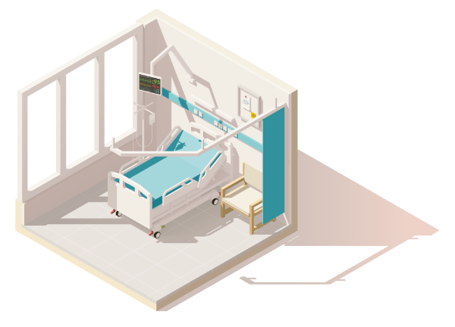

Three categories of HFA Quality of Care Centres
Community QCC
Specialised QCC
Advanced QCC
  Criteria for pre-assessment of Quality of Care Centres
  Target patients • Setting • Accessibility • Service portfolio/Equipment • Human Resources

Slide 7

Community QCC
Includes primary care institutions, resident cardiologists, and local (community-based) hospitals and rehabilitation centres.
Their role is to provide initial assessment and treatment of patients presenting with heart failure in the community setting and to ensure the optimisation
of therapy in chronic heart failure.

Slide 8

Specialised QCC
Includes district hospitals with intensive care units and
cardiac catheterisation facilities.
Specialised QCCs provide further
etiological diagnostic assessment and treatment, as well as treat decompensated HF patients of intermediate complexity.

Slide 9

Advanced QCC
Includes national reference centres that provide inpatient care for advanced/severely decompensated heart failure patients, and for heart transplant/mechanical circulatory support candidates and recipients.

Slide 10








 | COMMUNITY QCC | SPECIALISED QCC | ADVANCED QCC
TARGET PATIENTS | Chronic outpatients / rehabilitation Acute, not severe HF / mildly decompensated | Moderate HF complexity, New-onset HF / after recent hospitalisation | Severe / Advanced HF patients HTx and/or MCS candidates/ recipients
SETTINGS | Primary care Cardiology / rehabilitation Community hospital | CCU / ICU / chest pain unit and specialised wards in district hospitals | As in specialised QCC + Heart Surgery
ACCESSIBILITY | Elective Prompt (<48h) access if needed | On-Duty cardiologist 24/7 CCU/ICU dedicated beds | As in specialised QCC + Cardiac surgery in a heart team + ICU dedicated beds
SERVICE / EQUIPMENT | Therapeutic optimisation Patient & caregiver education Rehabilitation ECG, TTE, 24h ECG/BP Holter, laboratory tests Referral to higher level centers | Aetiology assessment, Therapeutic optimisation, Cardiac catheterisation, Arrhythmia ablation, ICD/CRT implantation TOE, CMR, CPET Renal replacement therapy | As in specialised QCC + Circ. Support HTx and/or MCS and follow up Cardiac surgery Valve intervention. EMB, genetic testing
HUMAN RESOURCES | Primary care Internists / Cardiologists Nurses | Cardiologist 24/7, HF nurses, Other specialties | As in specialised QCC + Cardiac surgeons 24/7 + Heart team
 | CCU, coronary care units CRT, cardiac resynchronisation therapy | HF, heart failure HTx, heart transplantation | ICU, intensive care units ICD, implantable cardioverter defibrillators MCS, mechanical circulatory support
Notes:
Mathilde
This visual will soon be added on the webpage and will help you and the centres determine the category they should apply to thanks to precise criteria in each section.
Indeed, there is one form is dedicated to the Community type, another to the Specialised type and the third one to the advanced one.

Slide 11


Two phases in the accreditation process
PHASE 1
PHASE 2
Pre-accreditation:
Identification of the centre’s category according to structural criteria
(type of patients, setting, accessibility, portfolio, equipment and staffing).
Validation of performance and application of the ESC Guidelines according to GDMT through data collected in the ESC's GRASP (the new Global Registries And Surveys Programme). Centres applying are required to enroll in GRASP-HF.

Slide 12
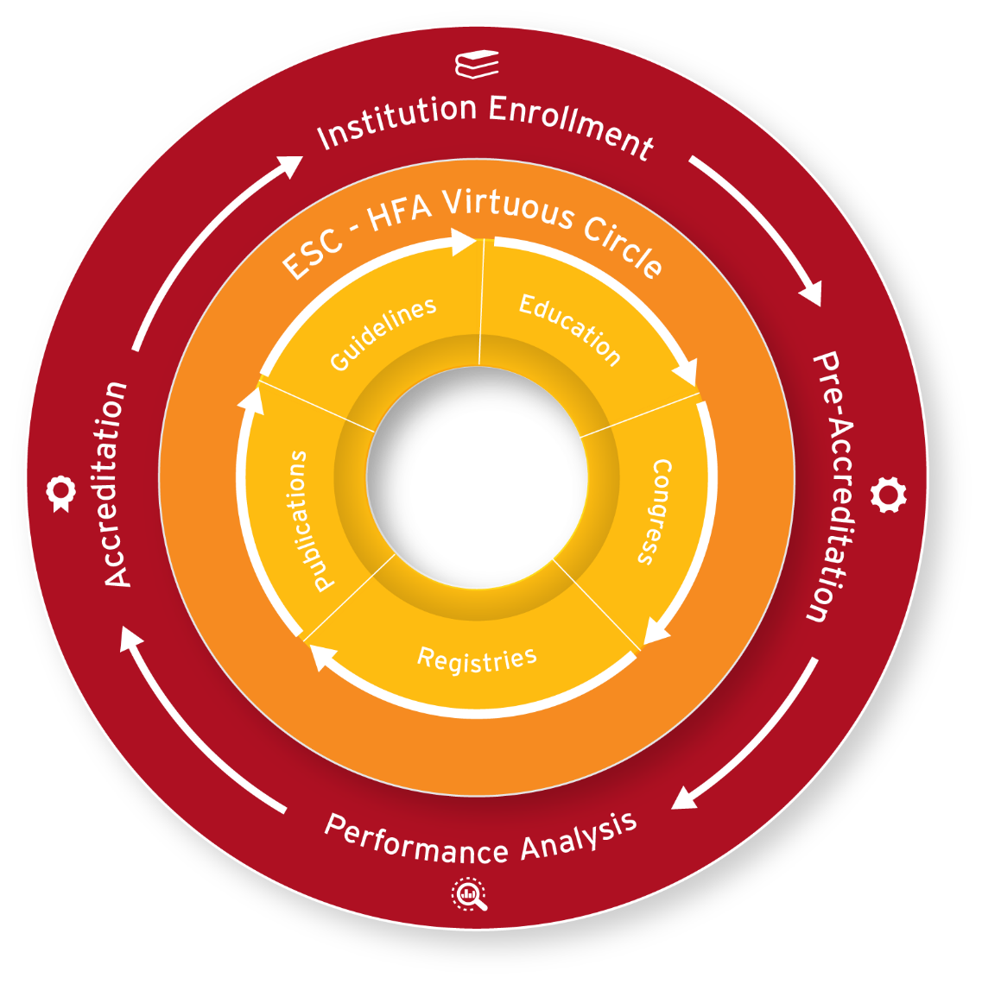
ICARe-HF cycle
Identification of gaps in education and research
Advise on future research and education
Verification of quality standards
Enrollment in GRASP
Creation of a network of
HFA Quality of Care Centres
Support individual centres in improving care
Assessment of centres performance
Verification of ESC Guidelines implementation
Notes:
The ICARe-HF cycle and the ESC virtuous circle are both models that aim for continuous improvement in cardiovascular care. Both models strive to promote excellence in cardiovascular care by providing feedback to healthcare providers, identifying areas for improvement, and promoting research and education.
The ICARe-HF cycle is closely aligned with the ESC virtuous circle by ensuring that participating institutions meet quality standards, collecting and analyzing performance data, and providing feedback to support continuous improvement. The ICARe-HF cycle can be divided into four phases:
Institution Enrollment: institutions willing to participate are evaluated to ensure they meet the accreditation eligibility criteria, including enrollment in the GRASP (Global Registries And Surveys Program) Heart Failure Snapshot
Pre-accreditation: enrolled institutions undergo a comprehensive quality process which evaluates the overall institution's performance in terms of training, equipment, staff, etc. The evaluation ensures that participating institutions demonstrate their compliance with a predefined set of requirements (standards) designed to improve the safety and quality of care and to ensure that they are following the recommended clinical practice guidelines for heart failure management.
Performance Analysis: specific variables related to main ESC Clinical Practices Guidelines and quality indicators for the evaluation of care and outcomes for patients with heart failure will be captured through an eCRF. Any gaps or areas for improvement are identified, participating institutions receive feedback on their performance and on measures that can be put in place to improve care.
Accreditation: during the final phase of the ICARe-HF cycle, pre-accredited institutions that have shown continued compliance with accreditation standards and have received feedback post data collection and analysis on care improvement are fully accredited by the HFA. This phase leads to the creation of a network of HFA accredited centers, and future institution can become part of this network via pre-accreditation first, and full accreditation later.
By creating a network of accredited centers, the ICARe-HF cycle helps to promote consistency in care across different institutions, which is essential for achieving better outcomes on a broader scale. In parallel, this process pushes new data relevant to care in the ESC registry process, generating new evidence that will impact the ICARe-HF accreditation standards and the ESC Clinical Practice Guidelines Committee’s assessment for future updated guidelines.

Slide 13
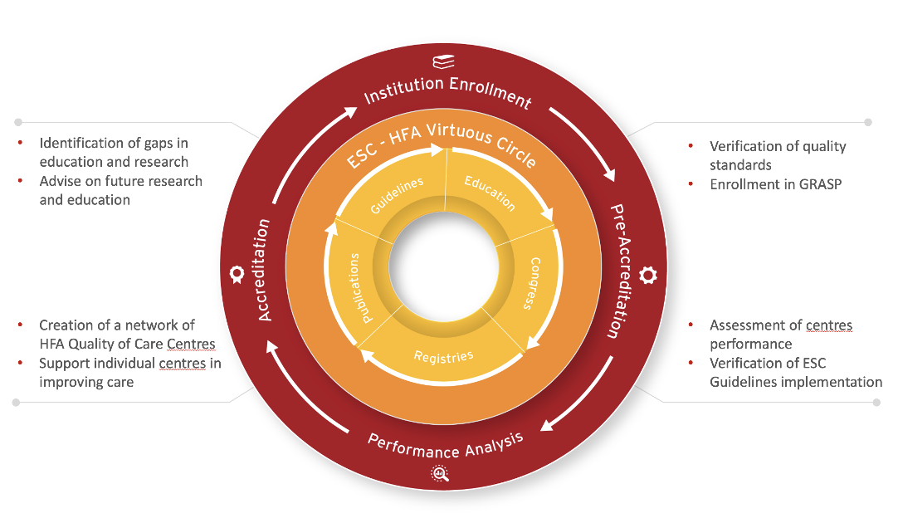
ICARe-HF Programme
GRASP-HF Snapshot

Slide 14
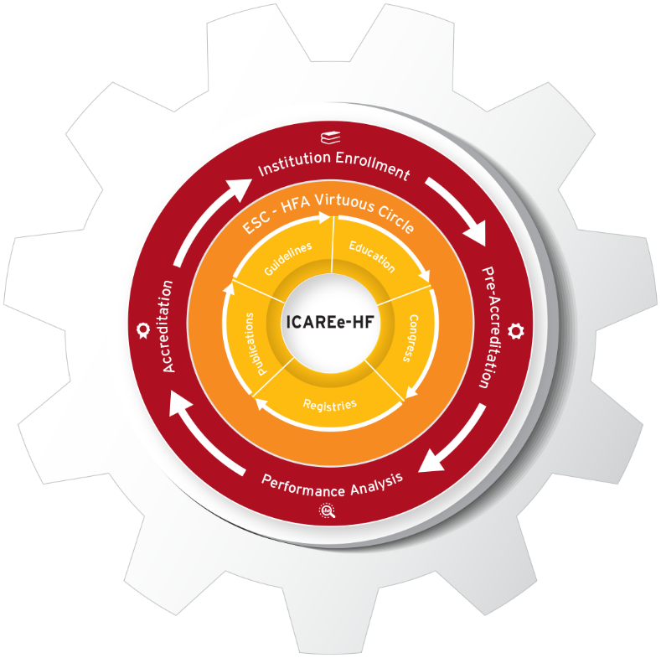

Generalizability
External validity
Reliability
Internal validity

Slide 15
ESC/HFA Guidelines
ESC
Educational
Programmes
NHFSs

Slide 16

Ideally…..repetitive assessment……
ESC/HFA Guidelines
4-5 YEAR CYCLE
ESC/HFA Guidelines
ESC/HFA Governance
ESC/HFA Governance
ICARe-HF
Control Monitoring
ICARe-HF
Control Monitoring
GRASP-HF
GRASP-HF
2 YEAR CYCLE
Gaps in Guideline’s implementation
Gaps in Quality of care
Gaps in Guideline’s implementation
Gaps in Quality of care

Slide 17

ICARe-HF will impact multiple
stakeholders, who are part of
an interdependent ecosystem
Scientific
community
Individual centres and clinics
Healthcare industry sponsors
Health authorities
Patients

Slide 18


ICARe-HF governance
ESC Board
HFA Board
Partners Committee
National Heart Failure
Societies and
Working Groups
GRASP-HF Snapshot Study Task Force
ICARe-HF Accreditation Committee
Project team (ESC staff)

Slide 19
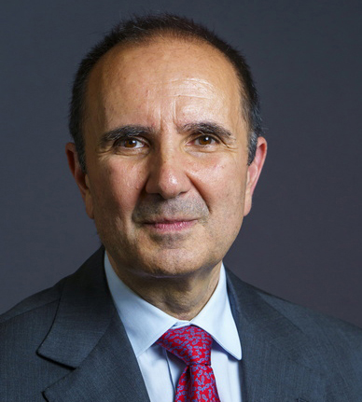







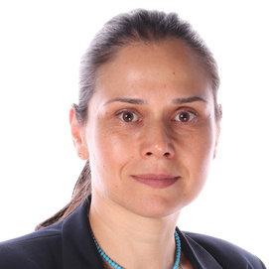



ICARe-HF
Committee
Giuseppe Rosano
Chairperson
Marco Metra
Co-Chairperson
L. Hill
B. Gellen
O. Amir
L. Anderson
M. Volterrani
G. Savarese
M. Tokmakova
O. Chioncel
S. Stoerk
A. Bayes Genis

Slide 20



National Heart Failure Societies are integral to the success of
ICARe-HF
and improving patient outcomes

Slide 21

A collaborative process with National Heart Failure Societies
The ICARe-HF Committee includes representatives from National Heart Failure Societies.
Institutions wishing to be accredited
are required to include a support letter from their National Heart Failure Society along with their application.

Slide 22
You are key to the success of ICARe-HF
Slides that explain the programme and how to get involved. You are invited to translate them if this would be beneficial.
National Heart Failure Societies (NHFS) will be the first point of contact to help institutions understand the value of ICARe-HF and how they can become accredited.
The HFA’s ICARe-HF Team will support you by providing:
A short video that explains ICARe-HF and what it can bring to institutions, heart failure care teams and patients.
A promotional slide to include in other presentations to drive awareness
A journal advert that you can resize for your national publication
Information and guidance

Slide 23
What is the timeline for the launch and implementation of ICARe-HF?

Slide 24

May 23
Oct 23
Nov 23
Dec 23
Jan 24
Feb 24
Mar 24
Apr 24
May 24
Jun 24
Jul 24
Sept 23
Aug 23
Jun 23
Jul 23
Aug 24
Sep 24
Oct 24
Nov 24
Dec 24
Jan 25
Feb 25
Mar 25
Apr 25
May 25
Jun 25
Jul 25
Aug 25
Sep 25
Oct 25
Nov 25
Dec 25
Jan 26
Feb 26
Mar 26
FY24
FY25
FY25
HF 2023
ICARe-HF
Presentation
From May 2023
to Oct 2023
Set-up of the accreditation programme
(criteria, accreditation forms, etc.)
HF 2024
Announcement of
ICARe-HF pre-accredited institutions
From May 2024
Monitoring of pre-accredited institutions, feedback, support centers in improving care
Validation of performance (through GRASP) and accreditation
HFA Summit
Launch of the ICARe-HF enrollment phase
From Oct 23 to Jan 24
Enrollment of institutions
From Feb 2024 to May 2024
Pre-accreditation of institutions
HF 2025
Presentation of HFA Quality of Care Centres
From May 2025
Monitoring of accredited institutions, feedback, support centres in improving care
Evaluation of ICARe-HF Phase 1 and preparation of Phase 2
Nov 23
Dec 23
Jan 24
Feb 24
Mar 24
Apr 24
May 24
Jun 24
Jul 24
Aug 24
Sep 24
Oct 24
Nov 24
Dec 24
Jan 25
Feb 25
Mar 25
Apr 25
May 25
GRASP HF
Snapshot
From Nov 23 to Nov 24
Sites recruitment & contracting
From May 24 to Nov 24
Data collection
Dec 24 to May 25
Data cleaning, review and analysis

